Slide 1
Depression
Presented by :: M Idrees Arif

Slide 2

What is Depression?
“Depression is the inability to construct a future.”
-Rollo May

Slide 3
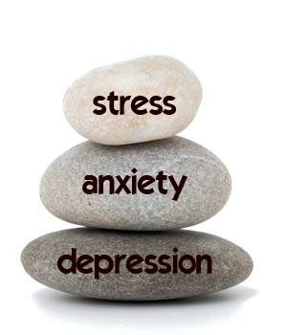
Anxiety & Depression

Slide 4
Signs & Symptoms of Depression
Emotional signs
Physical signs
Serious signs
“Depression is living in a body that fights to survive, with a mind that tries to die.”
--Alliedswing

Slide 5
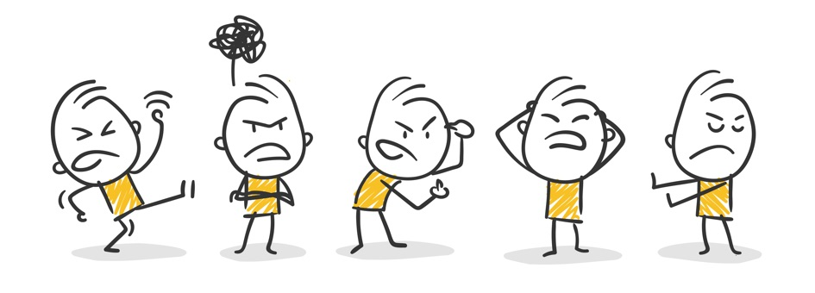
Emotional Signs
Angry outbursts
Avoiding friends
Feeling sad, empty, numb, hopeless, helpless, or worthless

Slide 6
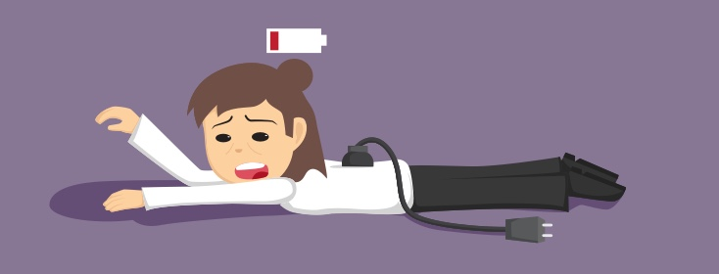
Physical Signs
Changes in energy level
Changes in eating
Changes in sleep patterns
Problems with concentration
Being unable to complete tasks
Sudden decrease in school or work performance

Slide 7
DEPRESSIVE DISORDERS
Dysthymia
Adjustment Disorder
Bipolar Disorder

Slide 8

Dysthymia
Negativity
Weight loss/gain
Guilt and worries about the past
Reduced quality of life
Reduced self esteem

Slide 9
Adjustment Disorder
Relationship problems
Experiencing the death of a loved one
Stress caused by physical changes in teenagers
Academic failure
Changing school
Being a victim of a crime
Having an accident
Undergoing a major life change (such as having a baby)

Slide 10
Bipolar Disorder
Emotional highs (mania or hypomania)
Feeling great
Having lots of energy
Talking very fast
Lows (depression)
Having difficulty focusing
Hallucinations
Delusions

Slide 11
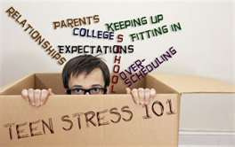

Slide 12
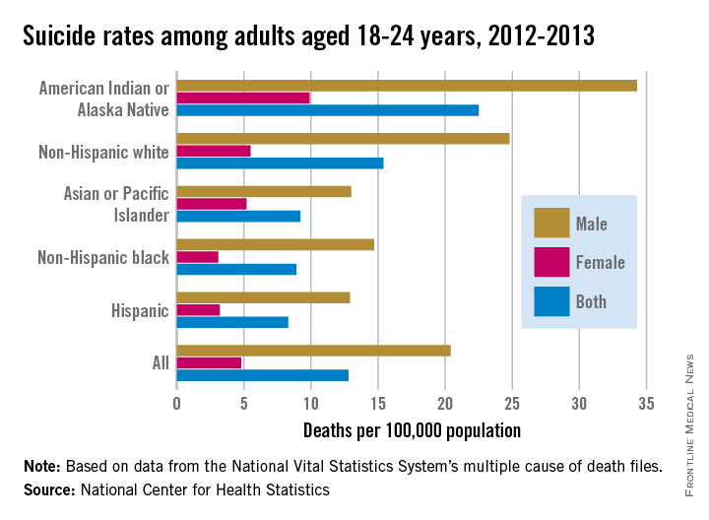

Slide 13
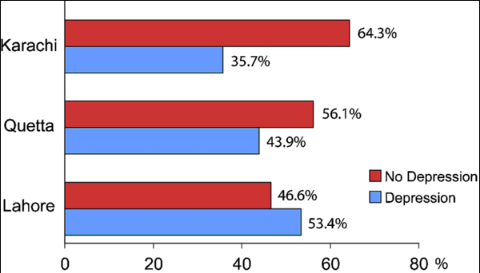
Ratio of depressed teens in Pakistan

Slide 14


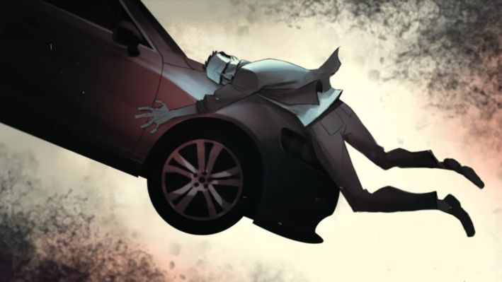

Diversions

Slide 15

How to deal with it?
Seeking professional help
Being part of a supportive community
Talking to a loved one or friends
Going outside or picking up a hobby
Getting regular exercise
Getting enough quality sleep on a regular basis
Eating healthy
Avoiding drugs

Slide 16

Talk to your Parents

Slide 17
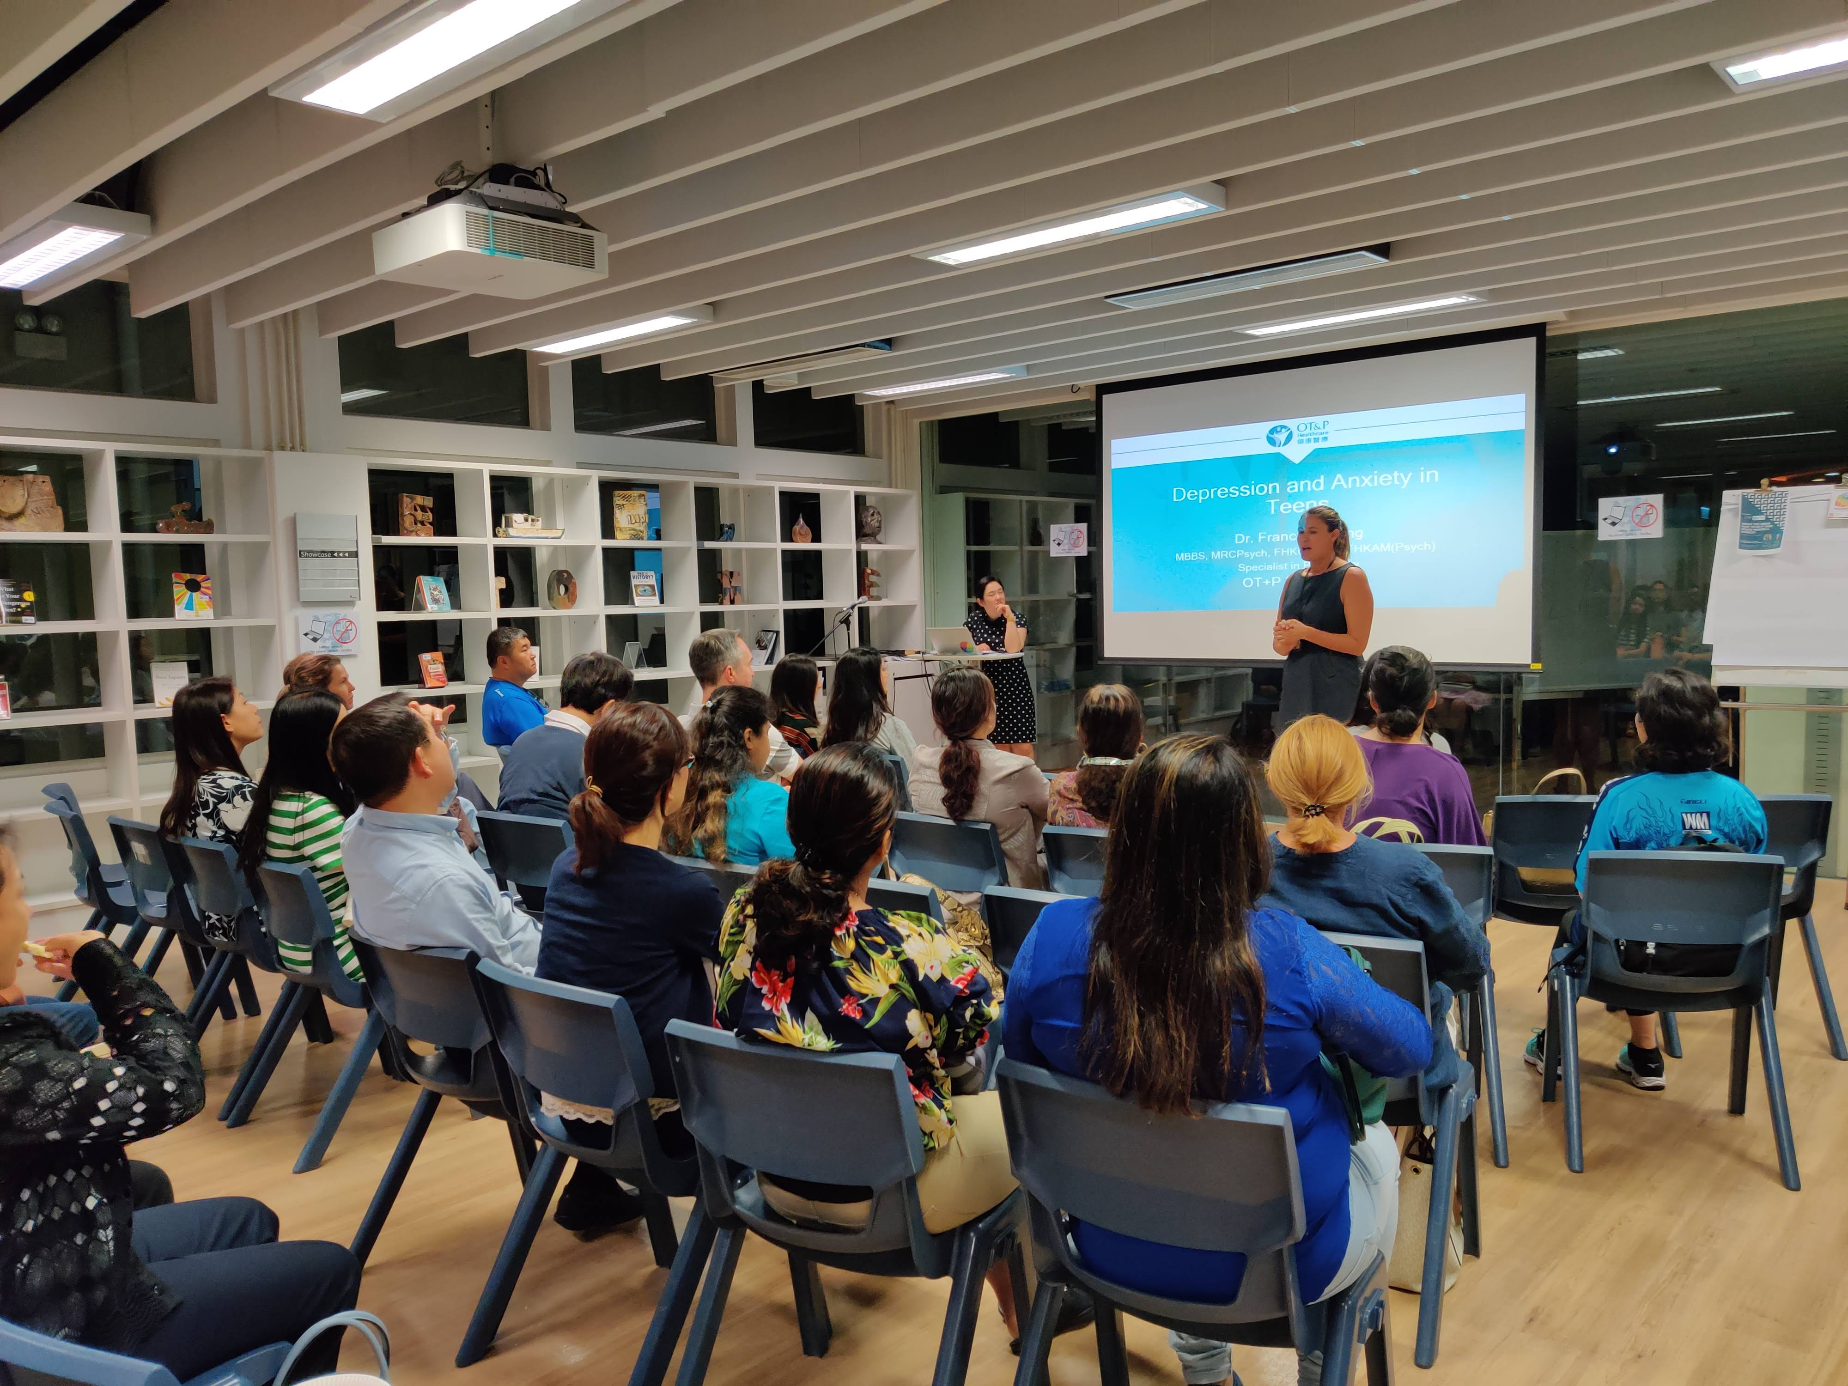
Talk to a Helping Professional

Slide 18
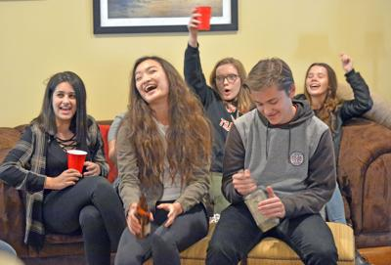
I need one of those long hugs where you kinda forget whatever else is happening around you for a minute.
--Marilyn Monroe

Slide 19
TIPS
Tip 1 – Understand that anxiety is not your fault
TIP 2 – Understand your subconscious power
TIP 3 – Discover a positive self-concept
TIP 4 – Learn to love and parent yourself

Slide 20


